Slide 1
Live green & Live Happy
Anupam Banerjee, Dante Burch, Gwen Hickey, Robert Gastineau, Shravani Mandalaparty

Slide 2
Background Information& Problem Statement
Background Information
Analyze data on 1,002 individuals engaged in 27 activities of daily life
Interpret activities in context of their carbon footprint as a way to promote environmental sustainability
https://www.mindsumo.com/contests/campus-analytics-challenge-2018
Problem Statement
Recommend environmentally-friendly changes to everyday actions without lessening individuals’ quality of life

Slide 3
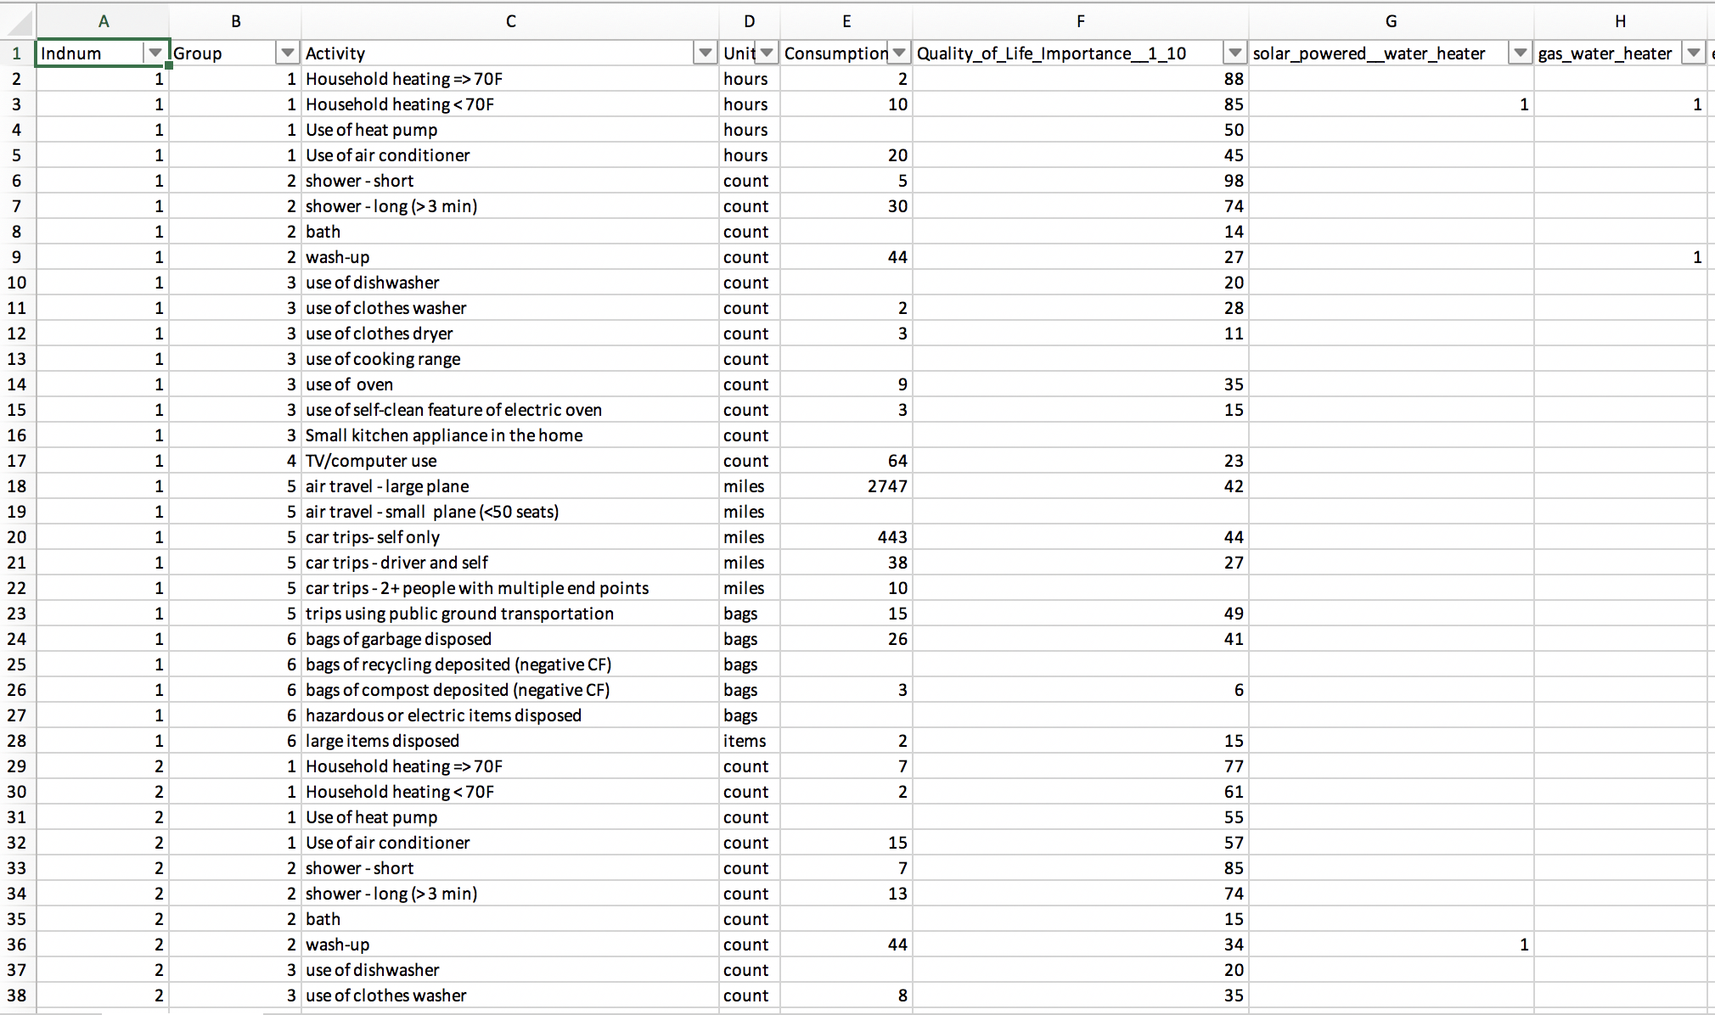
Data Set – Individuals
Data set consists of 1,002 individuals who rated 27 activities based on:
Consumption
QoL importance for each (1-100)

Slide 4
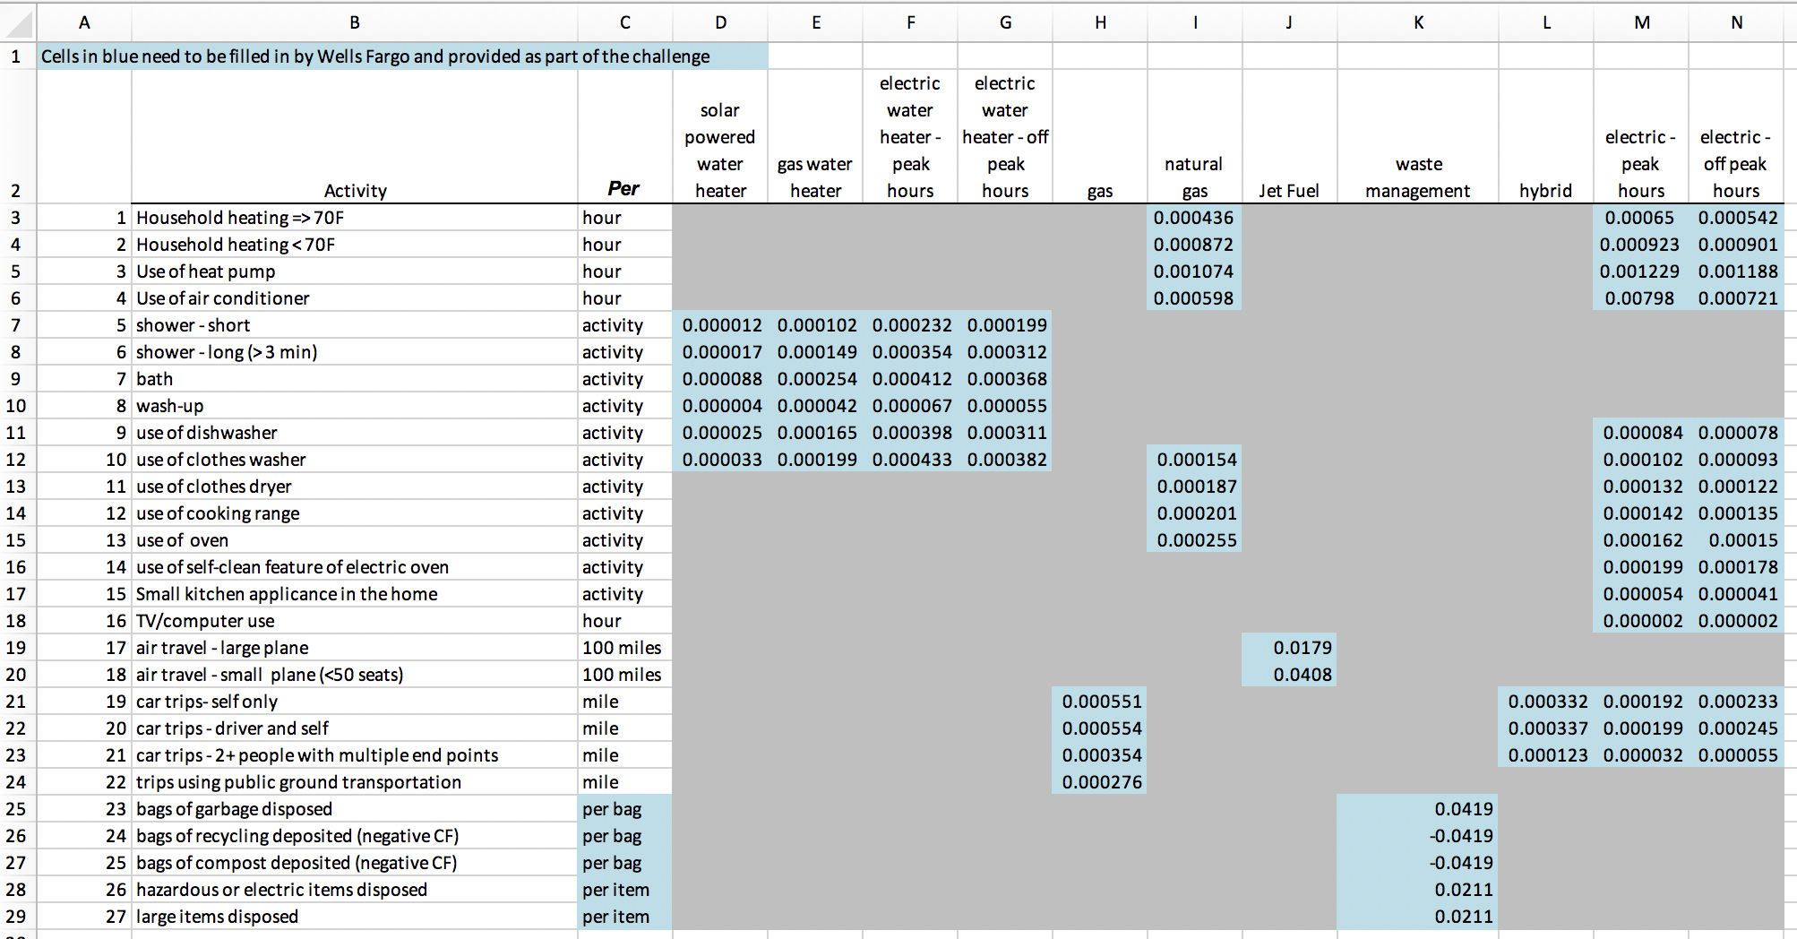
Data Set – Carbon Footprint
The carbon footprint and its associated energy source is specified for each of the 27 activities

Slide 5
Data Wrangling
Assume if a 1 exists for a particular activity, it should exist for all activities that use that energy source
Set data to 1 & 0 across all individuals and activities
Calculate Total Carbon Footprint (TCF) for each record
(Consumption * Activity Indicator (y = 1 / n = 0) * CF)
For blank values of Consumption, assume the Carbon Footprint is 0
For blank values of quality of life importance, populate it with the mean value – across all individuals – for the given activity
Average Carbon Footprint (matrix multiplication)
Anything above 0 → multiply that row * CF row
Total is the sum
Average is adding up anything greater than 0 / number of occurrences

Slide 6
Visualization

Slide 7
Constraints

Slide 8
Failures

Slide 9
Tools
R Studio
Tableau

Slide 10
Works cited

Slide 11
Questions?

